Slide 1

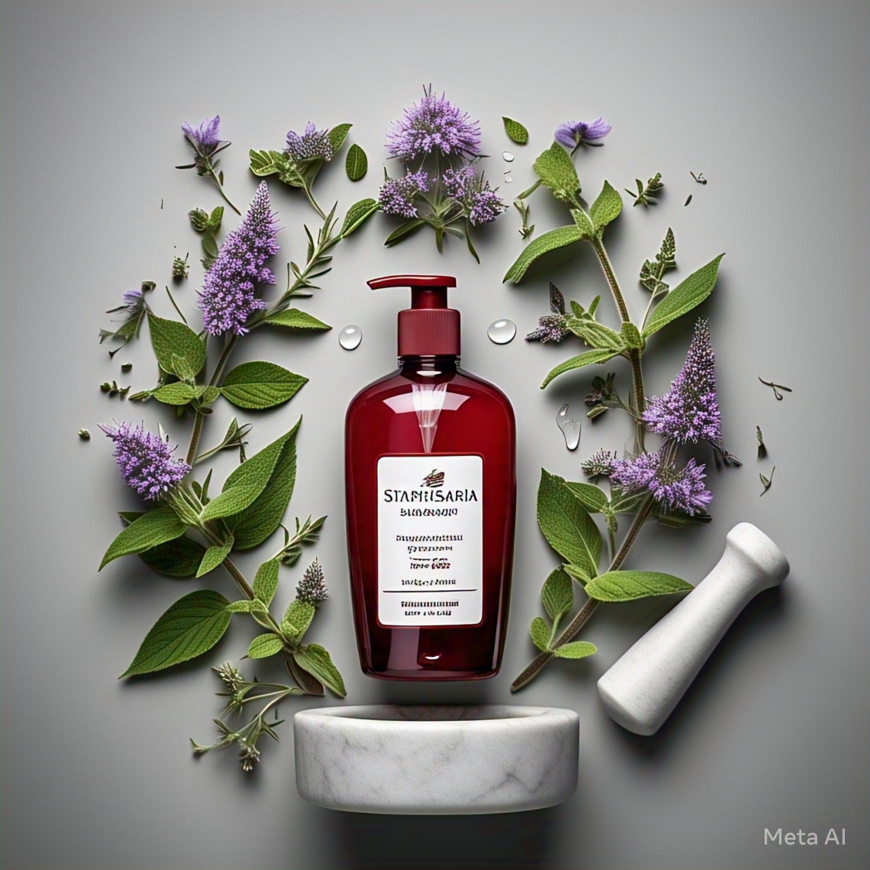
Staphysagria-Enriched NDDS Shampoo:
A New Horizon in Herbal Hair Care
StaphyCare
Staphysagria Enriched Phytosomal Shampoo
For Clear and Healthy Scalp

Slide 2
Introduction
Dandruff affects over 50% of the global population, often caused by microbial infections (C. albicans, S. aureus), stress, diet, and pollution.
Left untreated, dandruff can lead to seborrheic dermatitis, hair loss, and scalp infections, impacting both physical health and confidence.
Conventional shampoos contain harsh chemicals (sulfates, parabens) that provide temporary relief but fail to address the root cause of dandruff, leading to scalp irritation and long-term damage to hair.
Herbal alternatives often fail due to poor absorption into the scalp and lack of comprehensive benefits, typically only targeting one aspect like antifungal activity.
Staphysagria, used for centuries for its antifungal and antibacterial properties, is a proven remedy but underutilized in modern formulations.
By incorporating Staphysagria into an advanced delivery system, we enhance its absorption, ensuring effective treatment for both symptoms and the root cause of dandruff.
This innovation offers a safe, natural, and highly effective solution for dandruff, promoting long-lasting scalp health.

Slide 3
Need and Objectives
Rising Hair & Scalp Issues: Increasing cases of dandruff, infections, and hair loss demand safer and more effective alternatives.
Limitations of Conventional Shampoos: Synthetic shampoos contain harsh chemicals that cause irritation, dryness, and long-term scalp damage.
Staphysagria with Phytosomal Advantage: Staphysagria’s antimicrobial and soothing properties are enhanced using a phytosomal system, improving absorption, stability, and efficacy.
Eco-friendly & Innovative Solution: This research introduces a NDDS-based herbal shampoo, offering a sustainable, safe, and advanced approach to hair and scalp care.

Slide 4
Need and Objectives
To extract bioactive constituents from Staphysagria using an appropriate extraction method.
1
To perform preliminary phytochemical screening of Staphysagria extract to identify its bioactive constituents.
2
To develop and optimize a phytosome formulation using Staphysagria extract as the active ingredient.
3
To evaluate the phytosome formulation for key parameters such as entrapment efficiency, particle size, etc
4
To incorporate the prepared phytosome into a shampoo base to create a novel herbal shampoo formulation.
5
To evaluate the formulated shampoo for its antifungal and antibacterial activities for hair and scalp care concerns.
6
Effective Herbal Shampoo for Scalp & Hair Care
7

Slide 5
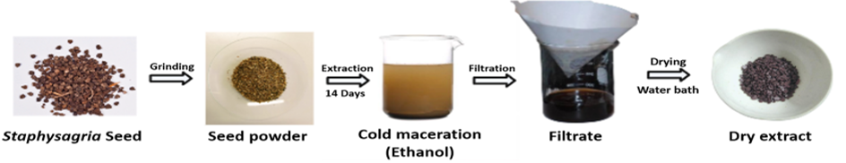
Experimental
Procurement of crude drug:
The crude drug (seed of Delphinum Staphysagaria Linn.) was obtained as a gift sample.
Authentication of crude drug:
The authenticity of the procured seed was confirmed by a botanist.
Processing of crude drug:
The seeds were subjected to drying under controlled shelter conditions and subsequently processed for extraction.
Extraction of crude drug:
Solubility analysis of extract:
Extract was soluble in ethanol and insoluble in water.

Slide 6
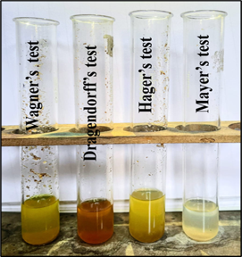
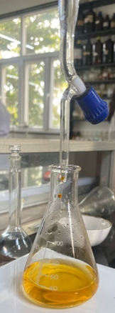
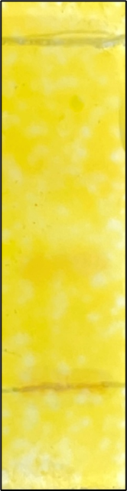
Experimental
Preliminary phytochemical screening of seed extract:
The analysis revealed the presence of key phytochemical which is alkaloids, which are known to contribute to its therapeutic properties.
Determination of Alkaloidal content:
Alkaloidal content was determined by Titration method.
Standardization of Extract:
8.1. Thin Layer Chromatography (TLC):
Co-TLC was performed with Delphinine using chloroform:methanol (9:1 v/v) as mobile phase and Dragendorff’s reagent as a Spraying agent.
Phytochemical tests
Total Alkaloidal Content
TLC

Slide 7
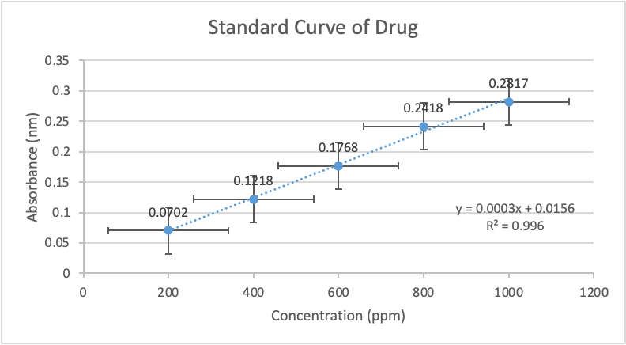
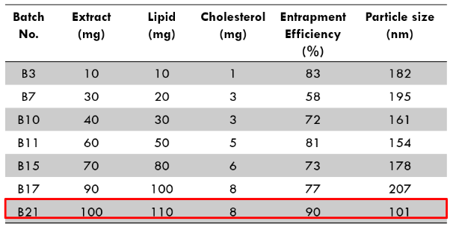
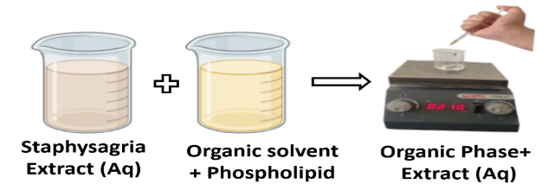
Experimental
8.2. Ultraviolet-visible (UV-Vis) Spectroscopy:
8.2.1. Determination of maximum wavelength (λ_{max}) and Standardization of extract:
An Absorption Spectrum was compared with standard alkaloid (Delphinine), to confirm its presence.
8.2.2. Preparation of standard calibration curve:
Preparation and Optimization of Phytosome:
Phytosome was prepared by solvent injection technique.
Several batches was prepared and particle size (nm) and Entrapment efficiency (%) was calculated for optimization of Phytosome.
Concentration (ppm) | Absorbance (270nm)
200 | 0.0702
400 | 0.1218
600 | 0.1768
800 | 0.2418
1000 | 0.2817

Slide 8
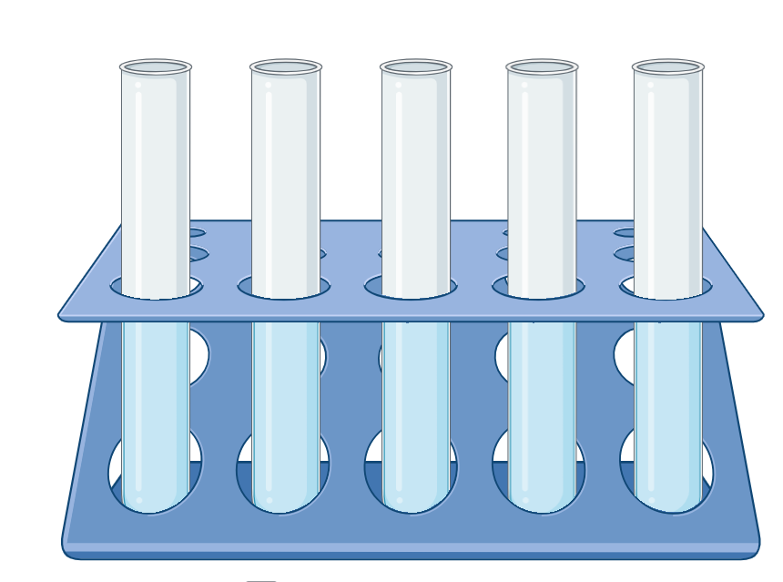
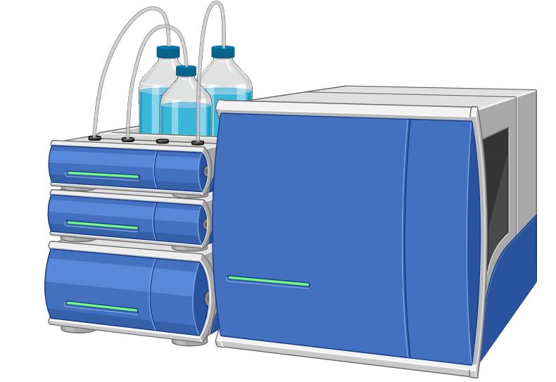
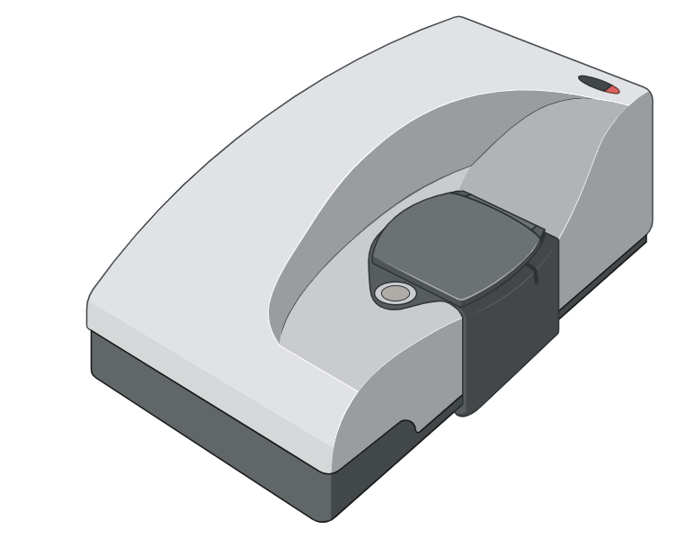
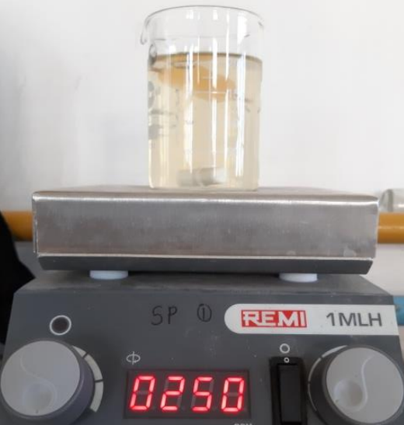
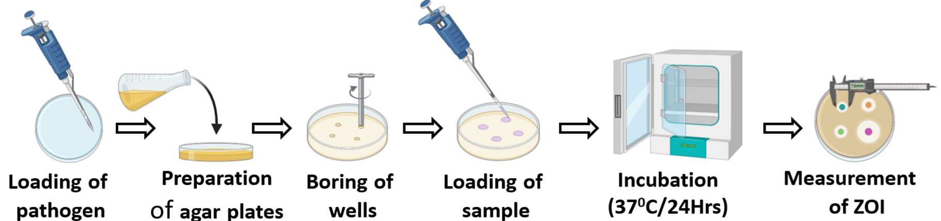
Experimental
FT-IR study:
FT-IR analysis was performed to identify the functional groups present in the staphysagria extract and confirm its chemical composition.
Evaluation of Phytosome:
Antimicrobial study of prepared shampoo:
The antimicrobial study of the formulation was conducted using the agar well diffusion method (Bore method).
Entrapment efficacy
Particle Size, PDI
Zeta Potential
Diffusion Study

Slide 9
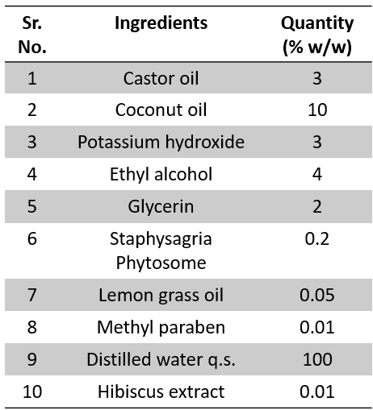
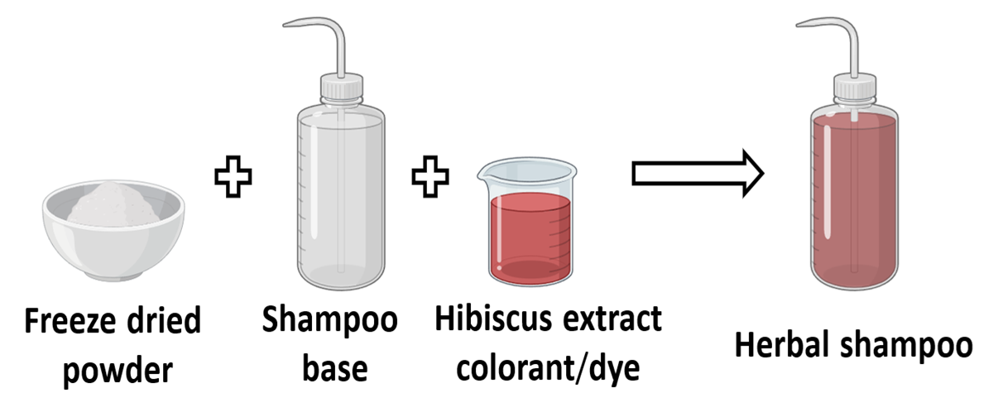
Experimental
Formulation of staphysagria enriched phytosomal shampoo:
13.1. Steps for Water-Based Hibiscus Extract
Fresh hibiscus petals are rinsed, separated, and added to boiling distilled water. The mixture is simmered for 15–20 minutes, then cooled and strained to remove residues, yielding a deep red extract.
13.2. Preparation of Phytosomal shampoo
Coconut and castor oils were saponified with KOH under reflux.
Glycerin and freeze-dried Phytosome were added with stirring, followed by ethyl alcohol, methyl paraben (preservative), lemongrass oil (fragrance), and hibiscus extract (colorant).

Slide 10
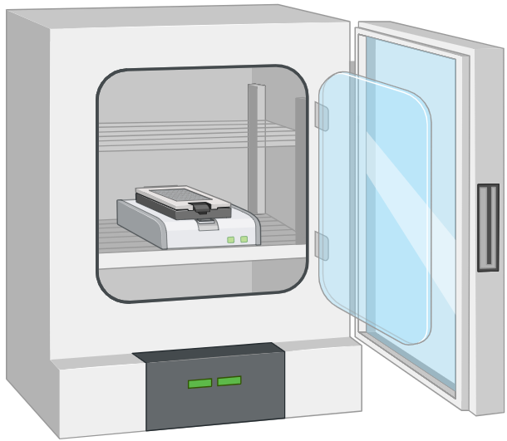
Experimental
Characterization of prepared shampoo
14.1. pH:
0.2% shampoo solution was used to determine the pH by using the pH meter.
14.2. Foam formation (Shake test):
2 ml sample of 0.2% shampoo was mixed with water, shaken in a covered measuring cylinder, and retained foam for over 15 minutes, indicating good foaming stability.
14.3. Skin irritation test:
The shampoo was applied to the skin for 5 minutes, showing no redness or irritation.
Stability Studies:
The stability study of Staphysagria-loaded Phytosome and Staphysagria-Enriched Phytosomal Shampoo under 30±2°C and 65±5% RH conditions was performed over three months, assessing particle size, entrapment efficiency, color, appearance, and pH, which remain stable with minimal variations
Stability Chamber

Slide 11

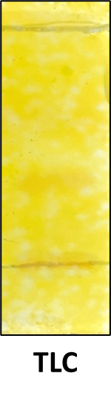
Results and Discussion
Extraction of crude drug and percentage yield:
Extractive value of Staphysagria seed was found to be 17.84%
Solubility analysis of extract:
Extract was found to be soluble in ethanol and insoluble in water.
Preliminary Phytochemical Screening:
Phytochemical screening revealed the presence of alkaloids, a key phytochemical known for contributing to its therapeutic properties.
Thin Layer Chromatography (TLC):
Rf value was found to be 0.55 which complies with the Delphinine of Homeopathic Pharmacopoeia of India Volume VI.
Phytochemical tests

Slide 12
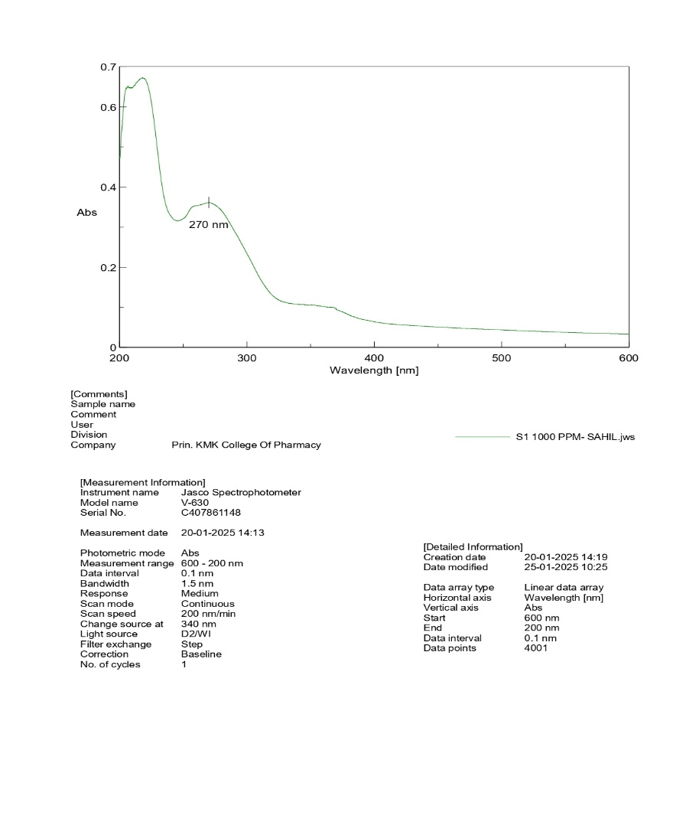
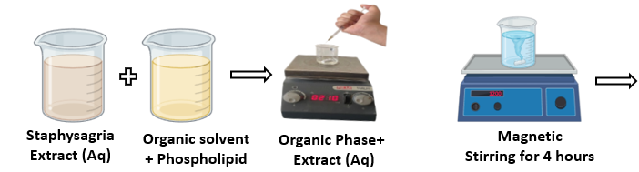
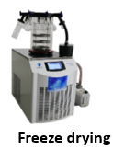
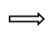
Results and Discussion
Determination of Total Alkaloidal Content:
Total alkaloidal content was found to be 2.916% w/w.
Determination of λmax:
λmax of Staphysagria extract was found to be 270 nm which complies with the λmax of Delphinine as per Homeopathic Pharmacopoeia of India Volume VI.
Preparation of Phytosome:
Phytosome was prepared by Solvent Injection Technique.
λ_{max} of Staphysagria extract (1000 ppm)

Slide 13
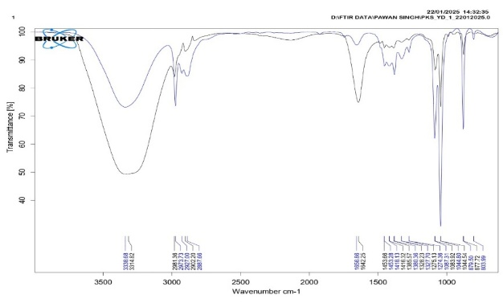
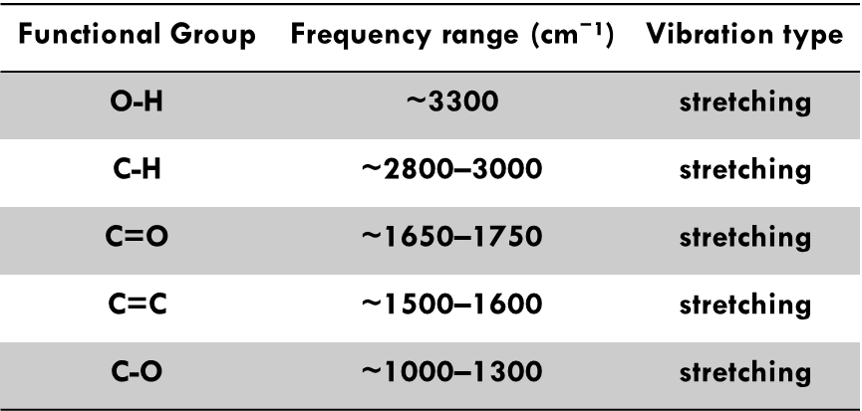
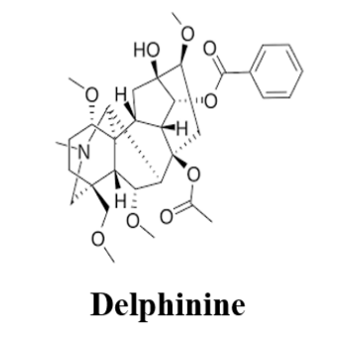
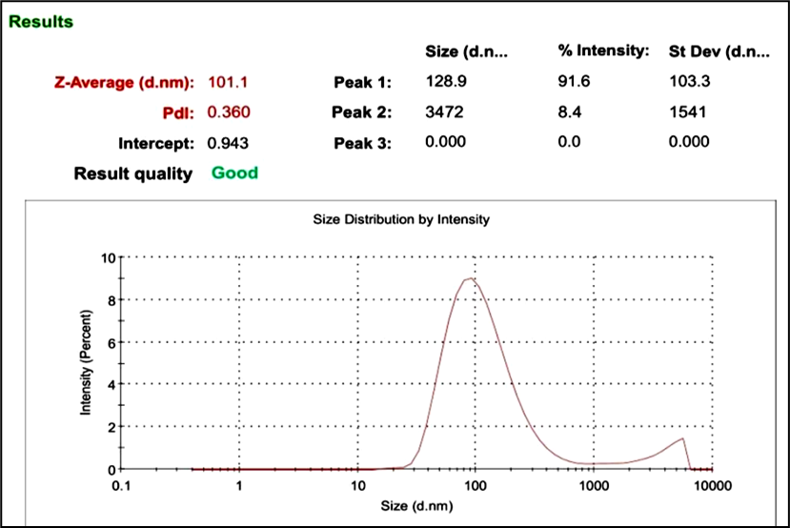
Results and Discussion
FT-IR Study:
Structure integrity: Primary functional groups of staphysagria are retained.
Drug-Excipient interaction: Reduced peak intensities and slight shift suggest possible interaction between drug and excipients in the formulation.
Formulation stability: Similarity in the spectral patterns of drug and formulation confirms the stability of formulation.
Evaluation of Phytosome:
9.1. Entrapment efficiency (%)
Entrapment efficiency of phytosome was found to be 89.70%
9.2. Particle size (nm)
Particle size of prepared phytosome was found to be 101.1 nm.

Slide 14
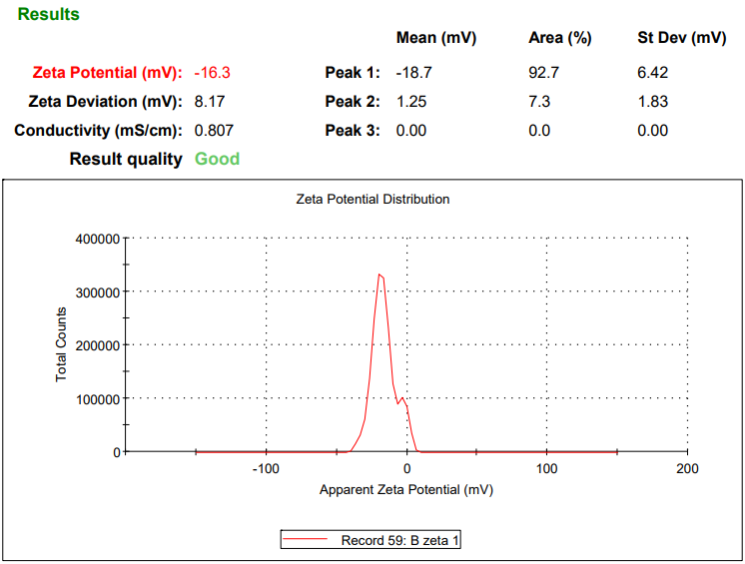
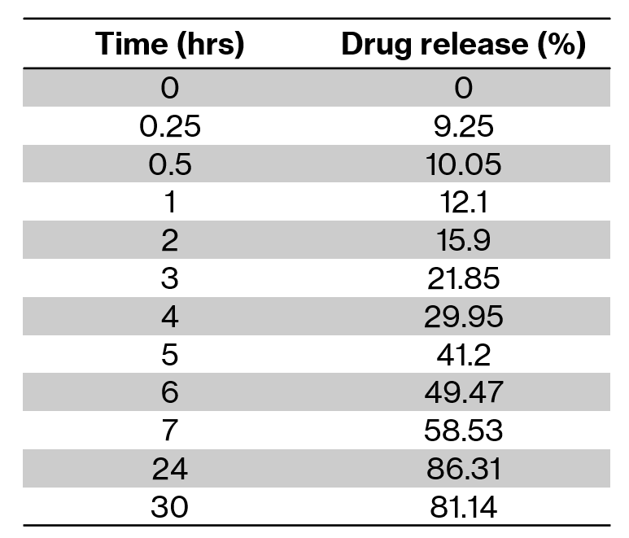
Results and Discussion
9.3. Zeta potential (mV)
Zeta potential of prepared Phytosome was found to be -16.30 mV.
9.4. Release study of Phytosome
% drug release was found to be 86.31% at 24 hours.
Zeta potential

Slide 15
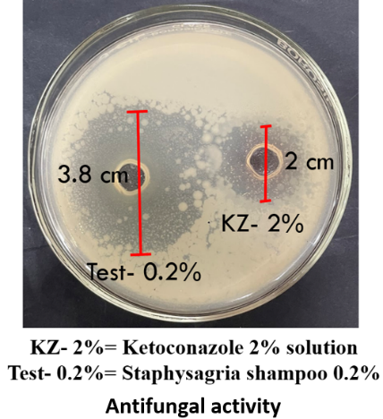
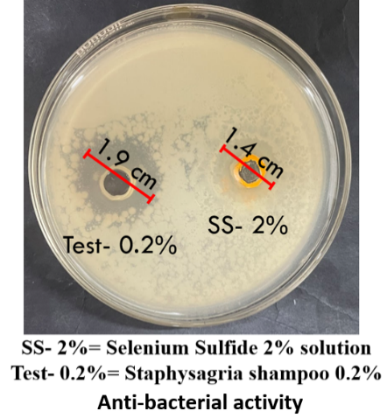
Results and Discussion
10. Anti-Microbial study of the prepared shampoo:
10.1. Antifungal Activity
The antifungal activity of the Staphysagria-based shampoo (0.2%) was evaluated against Candida albicans, with ketoconazole (2%) as the standard.
The shampoo demonstrated a significantly larger zone of inhibition compared to ketoconazole, indicating superior antifungal efficacy.
10.2. Anti-bacterial Activity
The antibacterial activity of the Staphysagria-based shampoo (0.2%) was assessed against Staphylococcus aureus, with selenium sulfide (2%) as the standard.
The shampoo exhibited a greater zone of inhibition than selenium sulfide, suggesting enhanced antibacterial activity.

Slide 16
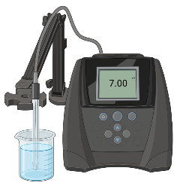
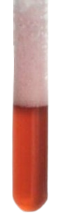
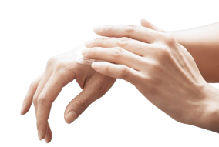
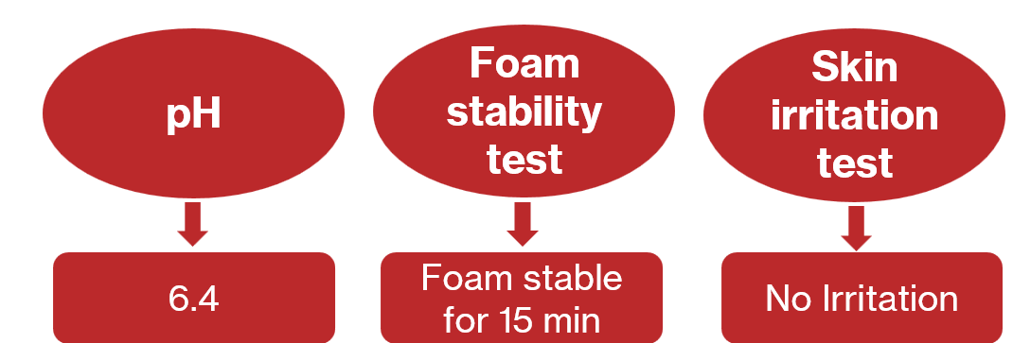
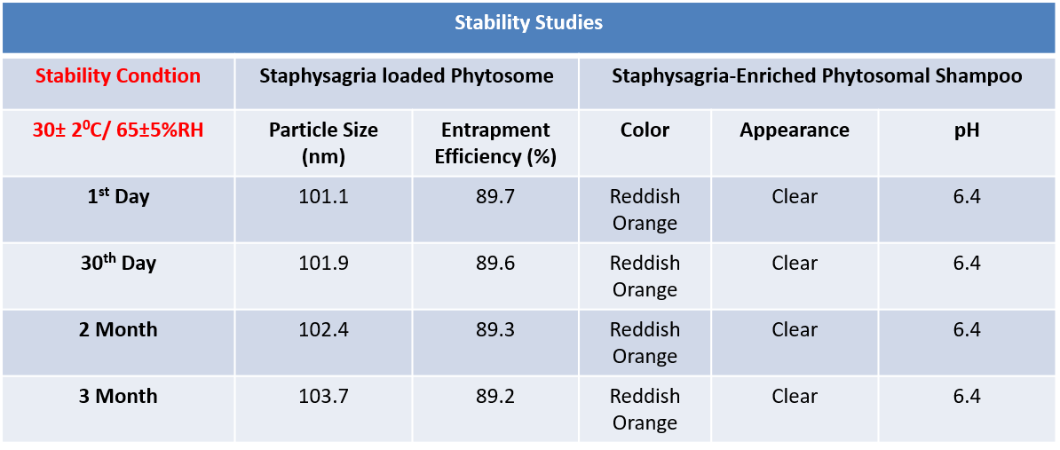
Results and Discussion
Evaluation of Staphysagria enriched phytosomal shampoo:
Staphysagria enriched phytosomal shampoo was prepared and evaluated for pH, foam stability and skin irritation test.
Stability studies:
Stability studies of prepared phytosomal batch and Staphysagria enriched phytosomal shampoo was performed as per ICH Guidelines.

Slide 17
Conclusion
The Staphysagria-loaded phytosomal herbal shampoo was successfully formulated and evaluated.
The phytosomal system enhanced bioavailability, stability, and scalp penetration, making it more effective than conventional formulations.
The shampoo exhibited ideal physicochemical properties, antimicrobial activity, and therapeutic potential for scalp health.
This research highlights a novel, eco-friendly, and effective NDDS-based approach for herbal hair care, offering a safer alternative to synthetic shampoos.
Further studies can explore clinical efficacy and long-term stability to establish its commercial viability.

Slide 18
Refrences
Espinosa F, Deroin T, Malécot V, Wang W, Pinedo M, Nadot S, Jabbour F. Historical note on the taxonomy of the genus Delphinium L.(Ranunculaceae) with an amended description of its floral morphology. Adansonia. 2021 Jan;43(2):9-18.
Yin T, Cai L, Ding Z. An overview of the chemical constituents from the genus Delphinium reported in last four decades. RSC advances. 2020;10(23):13669 86.
Xu Y, Zhang Z, Liu B, Sun D, Li H, Chen L. Polyphenols with anti-inflammatory activity isolated from the whole herbs of Delphinium forrestii var. Viride. Fitoterapia. 2024 Dec 1;179:106259.
Shurovi FS. Determination of Antioxidant and Antimicrobial Activity of Dichloro methane Extract of Garcinia cowa stem (Doctoral dissertation, East West University).
Marín C, Ramírez-Macías I, López-Céspedes A, Olmo F, Villegas N, Díaz JG, Rosales MJ, Gutiérrez-Sánchez R, Sánchez-Moreno M. In vitro and in vivo trypanocidal activity of flavonoids from Delphinium staphysagria against Chagas disease. Journal of natural products. 2011 Apr 25;74(4):744-50.
Miles JE. A survey of insecticidal activity from Delphinium X cultorum cv. magic fountains flowers. Michigan State University; 1998.

Slide 19
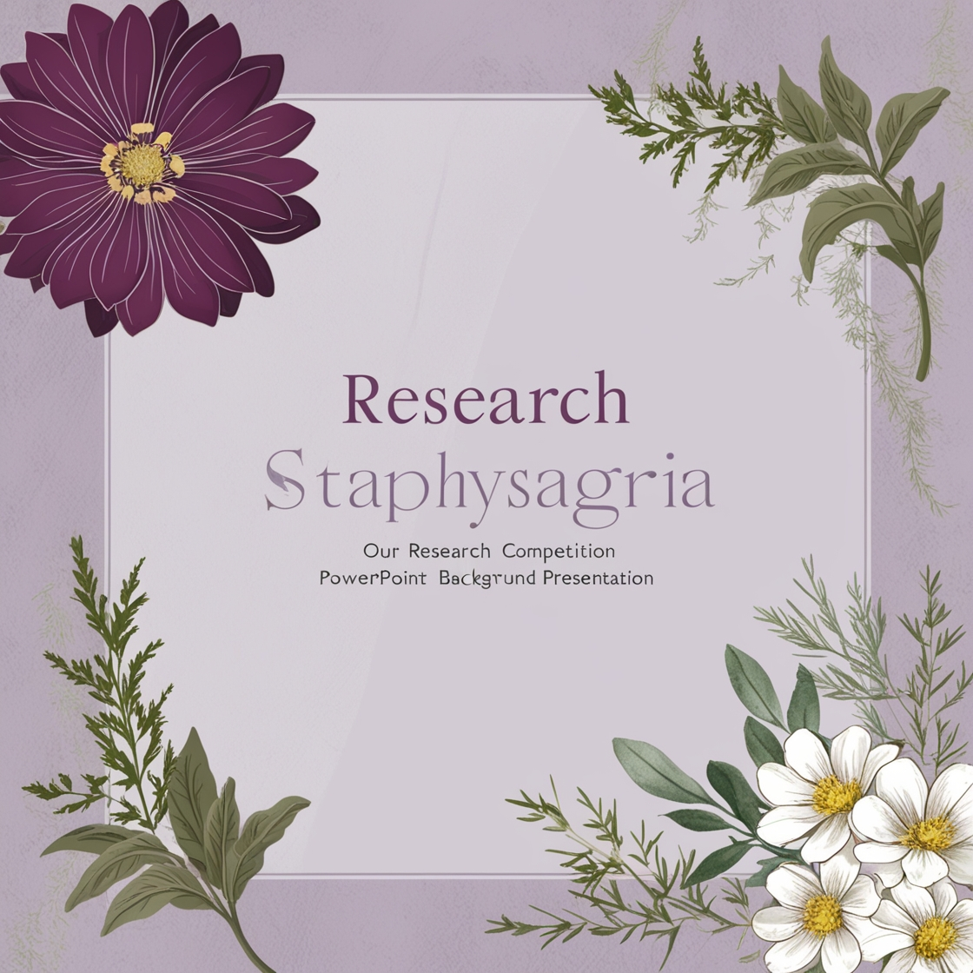
THANK YOU

